Slide 1

Crime under Domestic Violence Act
Khushbu Prasad
Programme Leader (HOI),
Assistant Professor (Law)
Amity University
Patna

Slide 2
Philosophy behind D.V. Act
Why we need???
Constitution
Society
History

Slide 3
Philosophy behind D.V. Act
An Act to provide for more effective protection of the rights of women guaranteed under the Constitution who are victims of violence

Slide 4
Acts under D.V. Act?
Physical violence

Slide 5

Acts under D.V. Act?

Slide 6
Acts under D.V. Act?
Sexual violence (Pornography, obscene pictures etc.)
Verbal and Emotional violence (Insults and name calling)
Economic violence
(Stopping from employment,taking
away salary etc.)

Slide 7
Who is the perpetrator?
Any person whether husband or relative of the husband in a domestic relationship with the aggrieved party
Applicability?
Applicable to live-in-relationships( with background of the case) not just married woman but not all live-ins

Slide 8
Live-in-relationships
Guidelines/points for live-in-relationships :-
Duration of relationship
Shared household
Pooling of resources and financial arrangements
Domestic arrangements
Sexual relationships
Socialization in public
Intention and conduct of the parties

Slide 9
How D.V. Act can help you?
Under the Protection of Women from Domestic Violence Act, one can get following reliefs/orders:-
Protection order (from any act of domestic violence)
Residence orders- right to reside
Monetary relief

Slide 10
How D.V. Act can help you?
Custody orders
Compensation orders
Interim and ex-parte orders

Slide 11
Where you can file a case?
Judicial magistrate of Ist class or Metropolitan magistrate within the local limits-
Aggrieved party permanently or temporarily resides or carry on business or employed
Where the perpetrator permanently,
or temporarily resides or carry
on business or employed

Slide 12
Contd…
The cause of action had taken place

Slide 13
Other Applicable Laws?
Indian Penal Code –Sec. 498A
Punishment and Fine
CrPC – procedural law

Slide 14
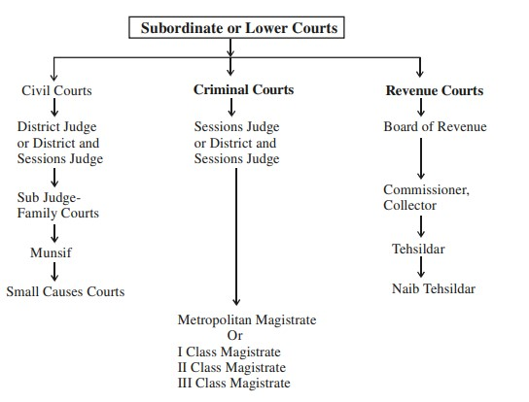

Slide 15
Thank You

